Slide 1
Excerpts from the FBI file on Philip Agee
obtained and released by Cliff Kincaid, President,
America’s Survival, Inc. www.usasurvival.org
The Edward Snowden case looks increasingly like the NSA equivalent of Philip Agee, who defected from the CIA and became a Soviet and Cuban agent. Agee died in Havana after writing several books with the help of Cuban intelligence.

Slide 2
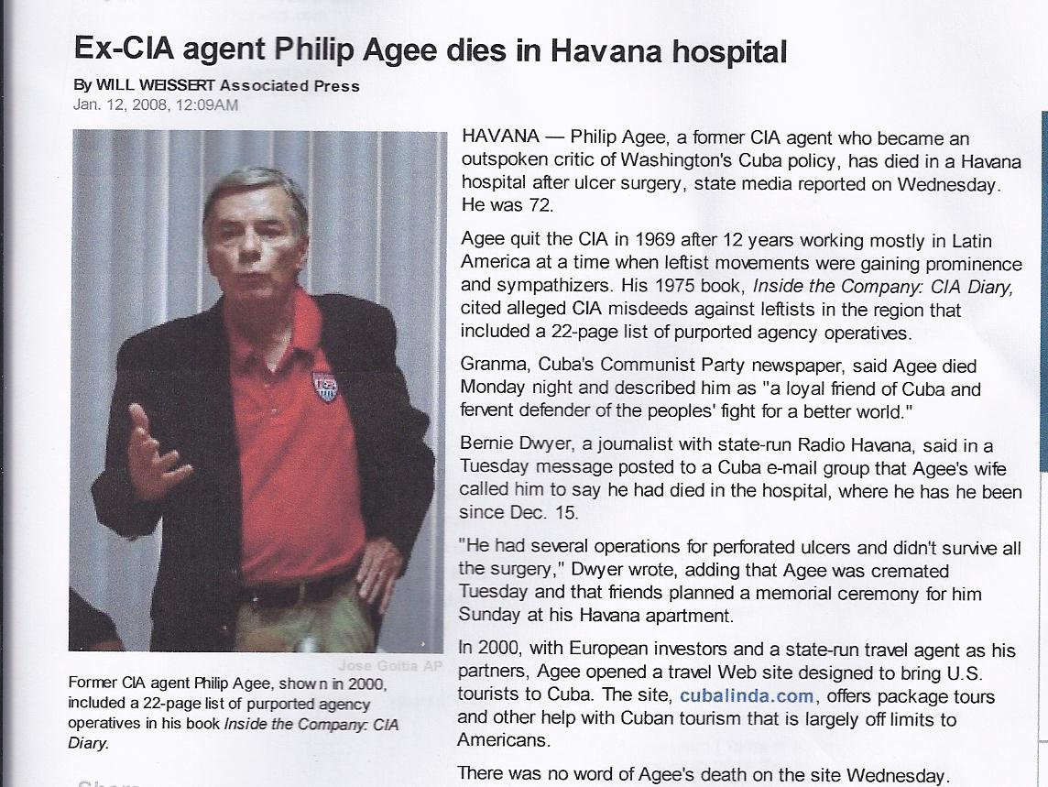
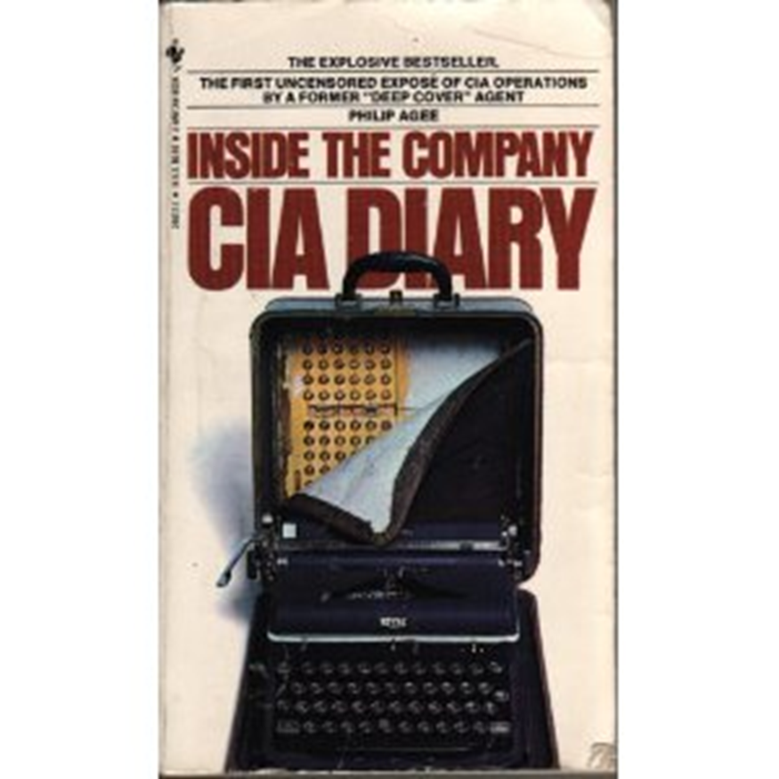
Traitor Philip Agee: never prosecuted and never served a day in prison. Protected by the Department of Justice.

Slide 3
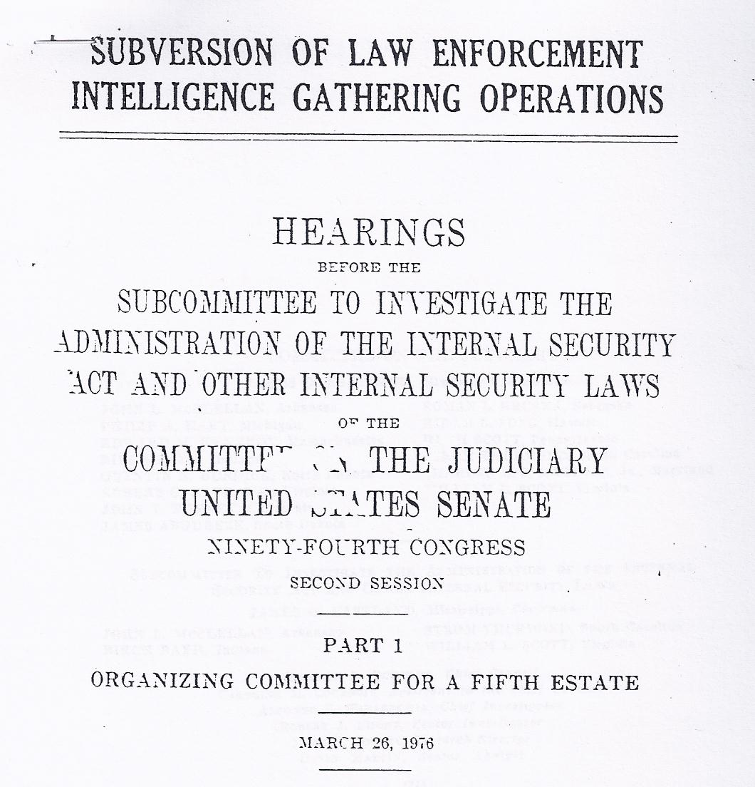
The Congress once had congressional committees and subcommittees to investigate the activities of traitors like Philip Agee, Edward Snowden, and the organizations backing them. Those panels have been abolished.

Slide 4
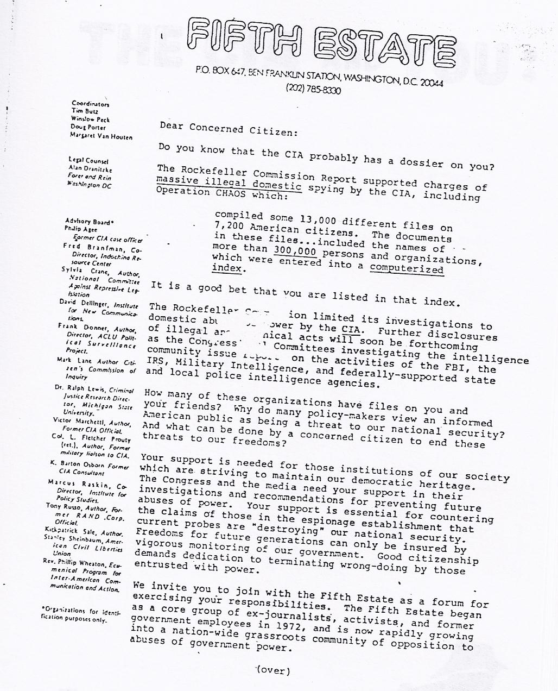
Agee was on the board along with such leftist notables as Marcus Raskin of the Institute for Policy Studies and Communist ACLU official Frank Donner . The former director of the ACLU’s Project on Political Surveillance, Frank Donner was a member of the Communist Party USA (CPUSA) who traveled to Russia and had contacts with Russian espionage agents, according to his FBI file. He wrote several books attacking U.S. intelligence agencies, including the NSA. He especially hated the House Committee on Un-American Activities, which grilled him on his CPUSA activities. He took the Fifth. But Donner had the last laugh, as the committee and its successor, the House Committee on Internal Security, were abolished in the 1970s.

Slide 5
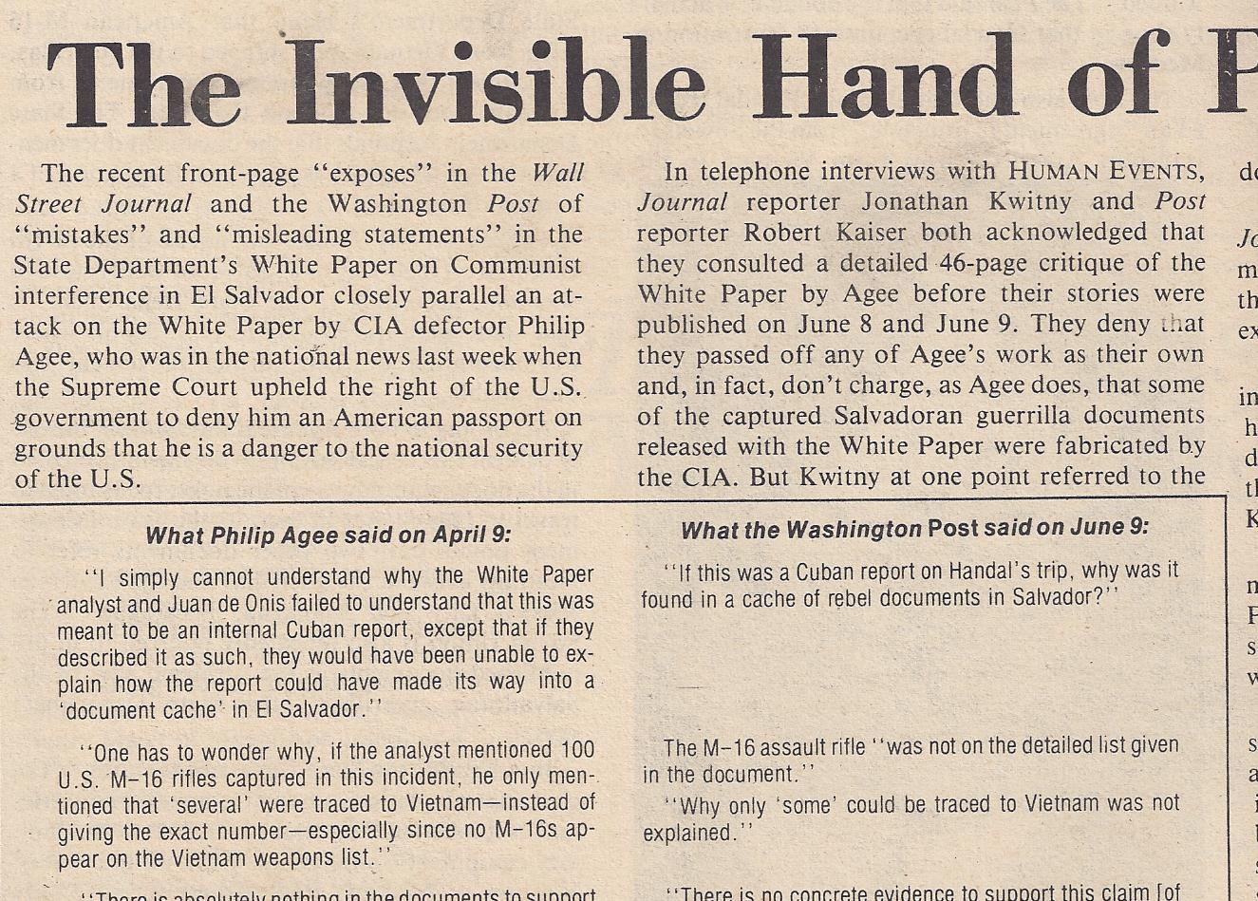
Human Events in 1981 exposed the fact that the Wall Street Journal and the Washington Post used Philip Agee as a confidential source in stories attacking the State Department’s “White Paper” on Communist interference in El Salvador. HE called this the “invisible hand” of Philip Agee.

Slide 6
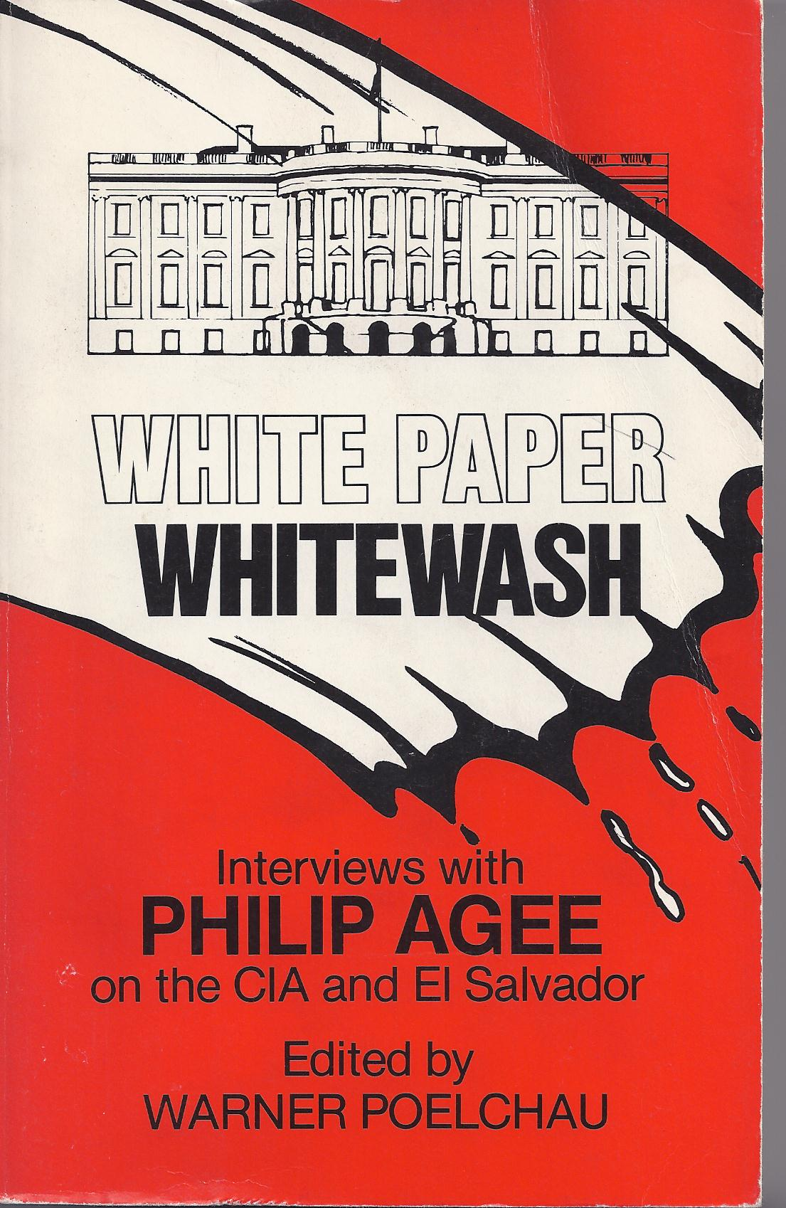

Slide 7
Agee acknowledged help of Cuba in his 1975 book, Inside the Company: CIA Diary.

Slide 8
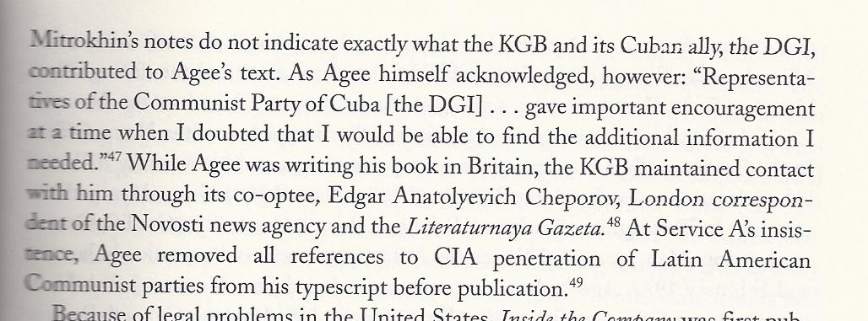
Excerpts from The Sword and the Shield The Mitrokhin Archive and the Secret History of the KGB By CHRISTOPHER ANDREW and VASILI MITROKHIN. Pages 230-231. Published 1999.
The Mitrokhin archive is described as a secret archive of top-level KGB documents smuggled out of the Soviet Union. Vasili Mitrokhin was a secret dissident who worked in the KGB archive.

Slide 9
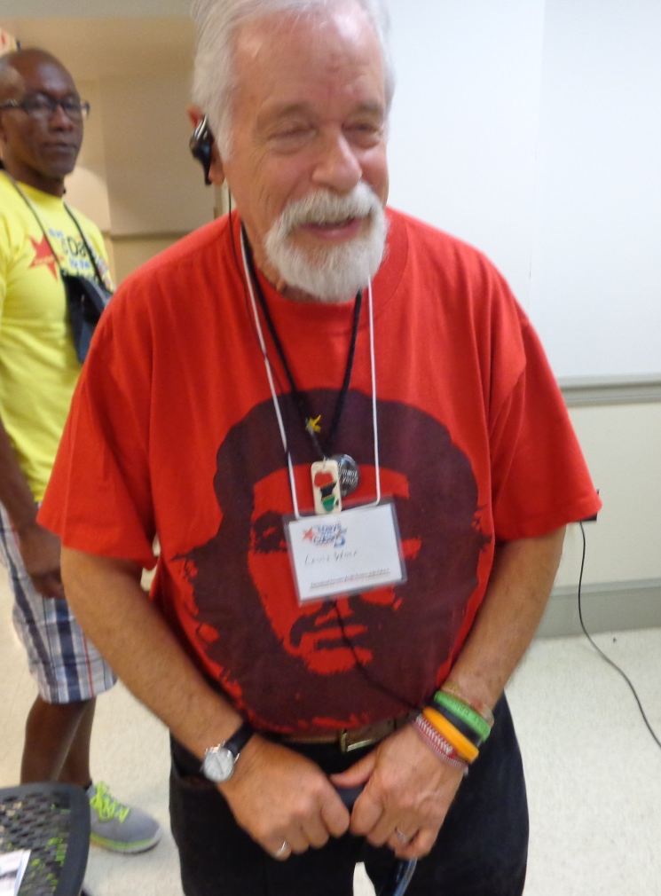
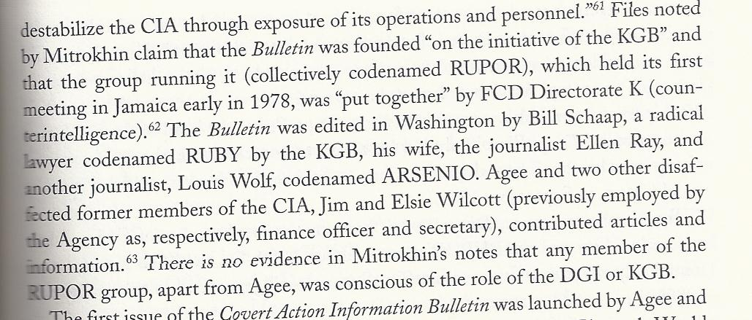
The role of the Soviet KGB and Cuban DGI in Agee’s Covert Action Information Bulletin. Louis Wolf (right) at “Free the Cuban Five” conference.

Slide 10
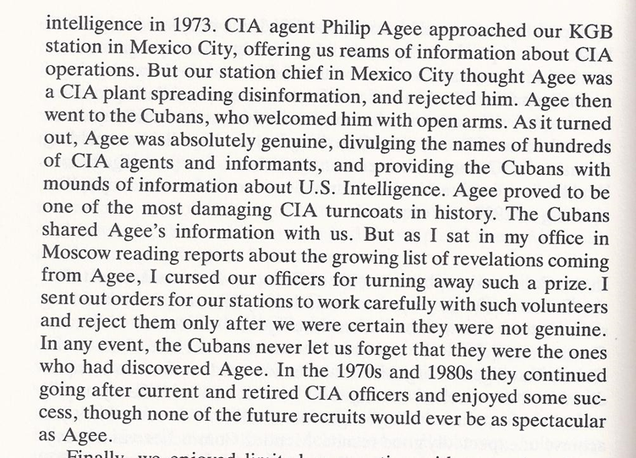
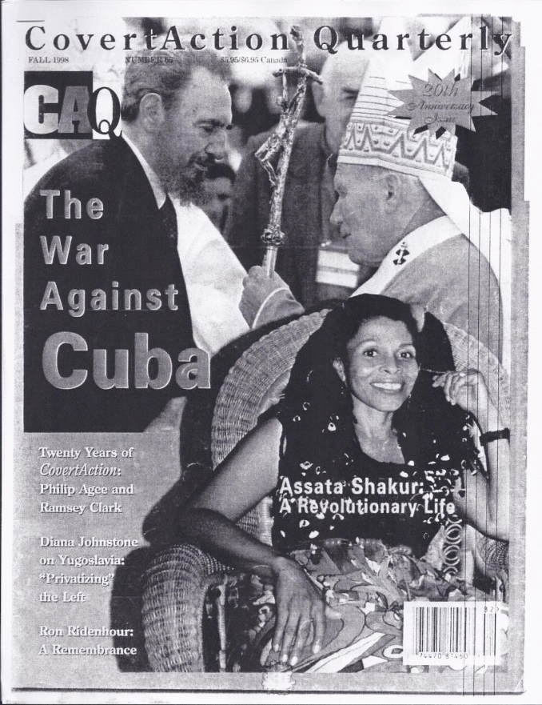
From First Directorate: My Thirty-Two Years in Intelligence and Espionage Against the West by former KGB Major General Oleg Kalugin. Published 1994.

Slide 11
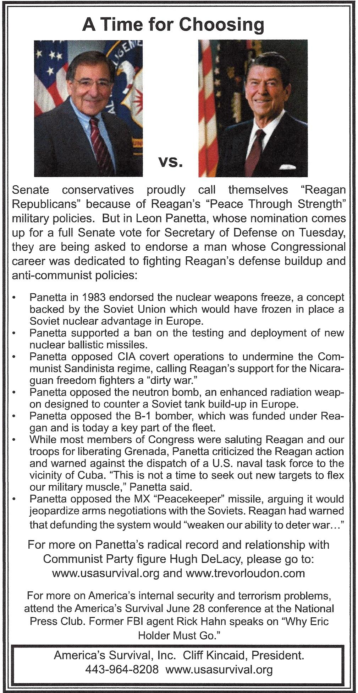
Former CIA director of Pentagon chief Leon Panetta and his wife were members of the “Celebration Committee” that highlighted the 20th anniversary of IPS in 1983, the same year the organization launched a series of conferences with the Institute of the U.S.A. and Canada, a front for Soviet intelligence activities.

Slide 12
Morton Halperin was nominated in 1993 to be Assistant Secretary of Defense for Democracy and Peacekeeping. He is now a senior advisor to the George Soros-funded Open Society Foundations. Senator John McCain said that Halperin “was closely involved with Philip Agee, whose extensive publication of the identities of American covert intelligence agents in foreign countries is attributed by some as the indirect cause of the assassination of Richard Welch in Athens.”
http://mccain.senate.gov/public/index.cfm?FuseAction=PressOffice.Speeches&ContentRecord_id=f63d086b-e341-4291-af2a-76f0d02b1719&Region_id=&Issue_id=

Slide 13
Attorney Leonard Weinglass, attorney for the Cuban spies known as the “Cuban Five,” on meeting with Agee in Cuba: “All of our meetings, some eight or nine, occurred in Havana, Cuba, where I had come while working on the defense of the Cuban Five, and where he resided with his wife, Giselle. What immediately impressed me was that he was living as a Cuban, not as some international celebrity, author, and ex-CIA officer. His was a fourth-floor walkup (the elevator had long since stopped running) and you got there by climbing a dark stairwell with a rusted-out metal banister. We drove around Havana in his more than ten-year-old Russian Lada…”
http://sdonline.org/51/remembering-philip-agee/

Slide 14
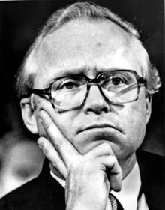
Benjamin S. Civiletti
Benjamin S. Civiletti, attorney general in the Carter Administration, facilitated the release of four unrepentant Puerto Rican terrorists, the dropping of charges against Weather Underground terrorists, had FBI officials indicted for violating the civil rights of friends and relatives of Weather Underground terrorists, and provided Agee with immunity from prosecution.

Slide 15
Philip Agee: Paid agent of Cuban Intelligence
April 1991 FBI document

Slide 16
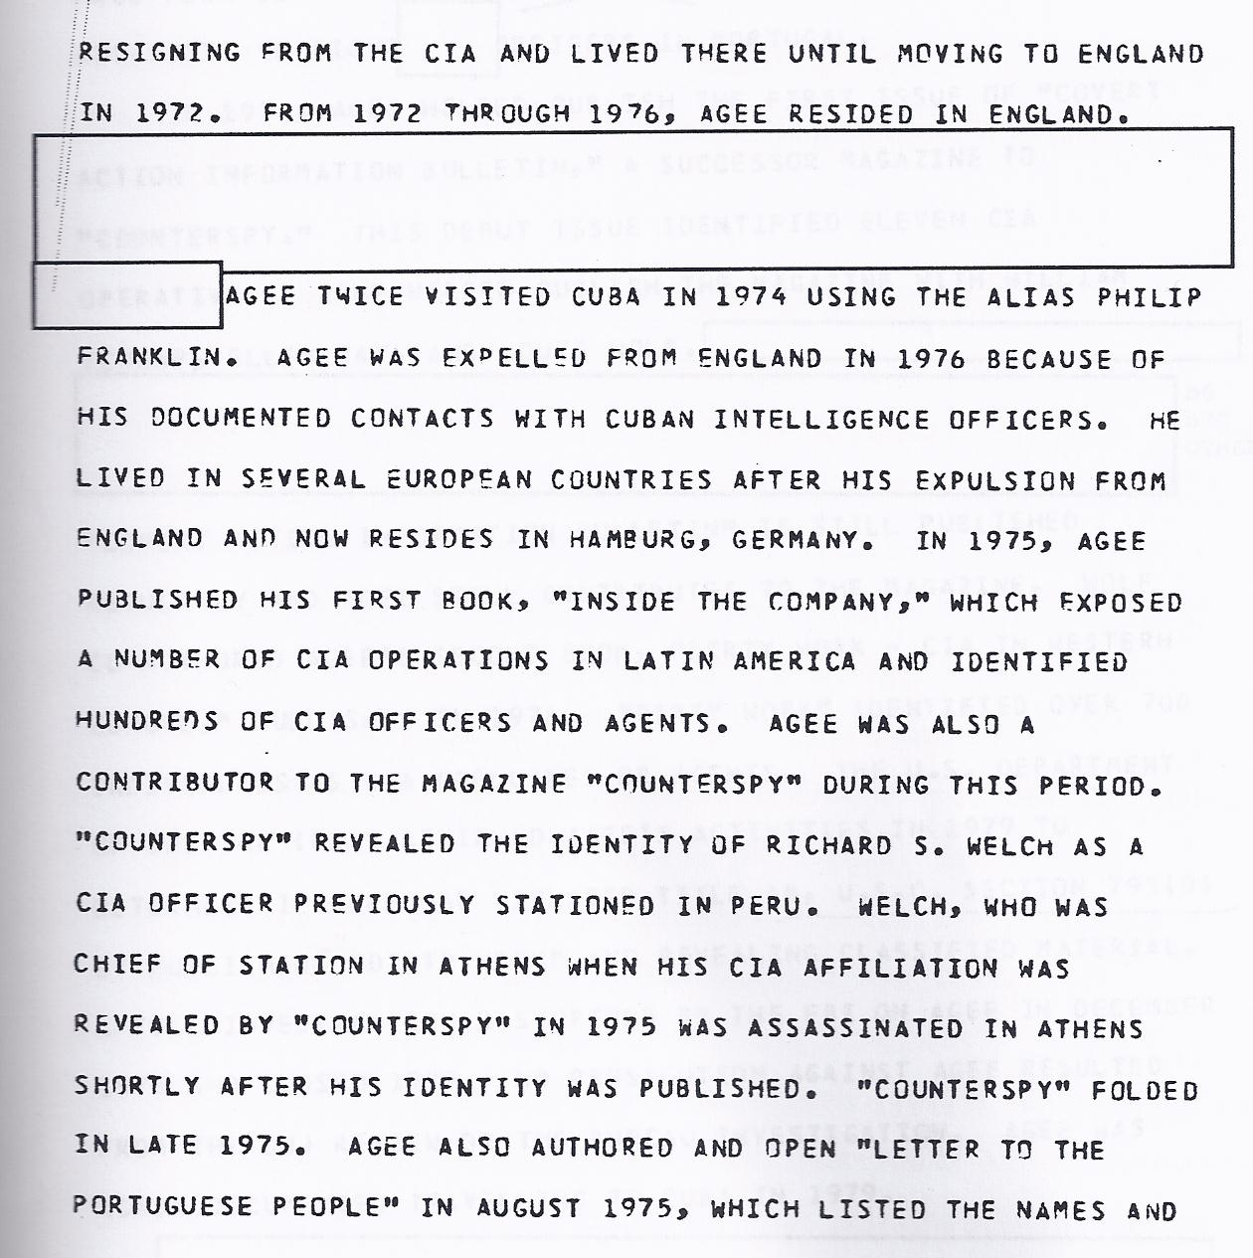
Agee is expelled from England for contacts with Cuban DGI
December 1991 FBI document

Slide 17
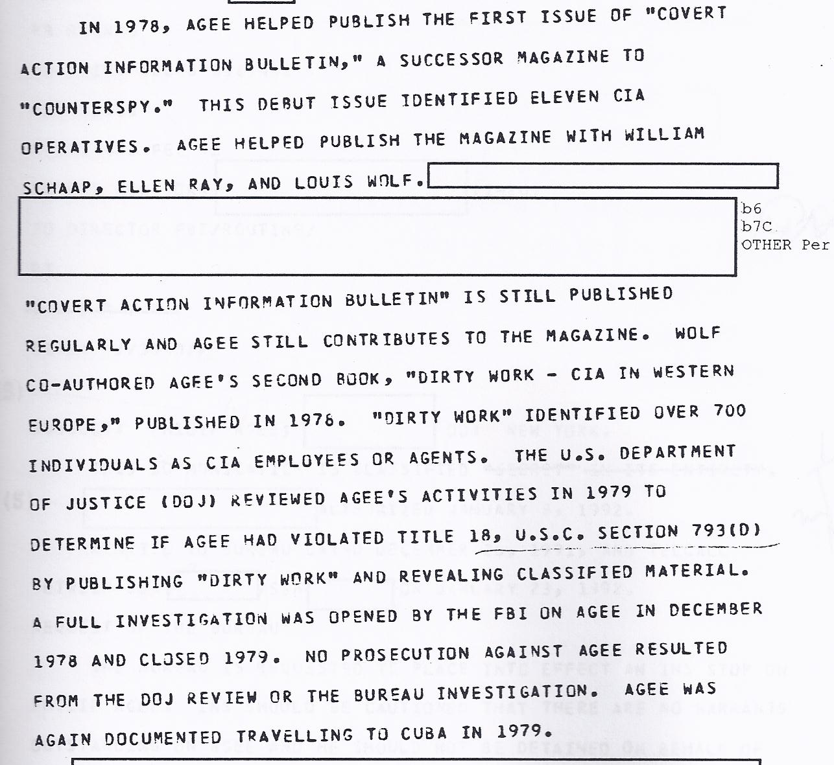
DOJ probe of Agee closed in 1979

Slide 18
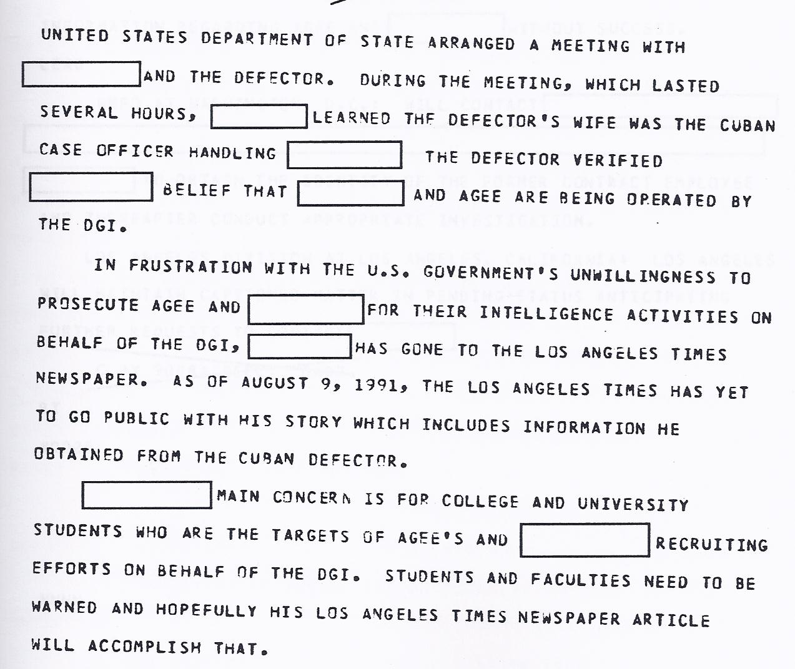
Frustration with U.S. Government’s unwillingness to prosecute Agee

Slide 19
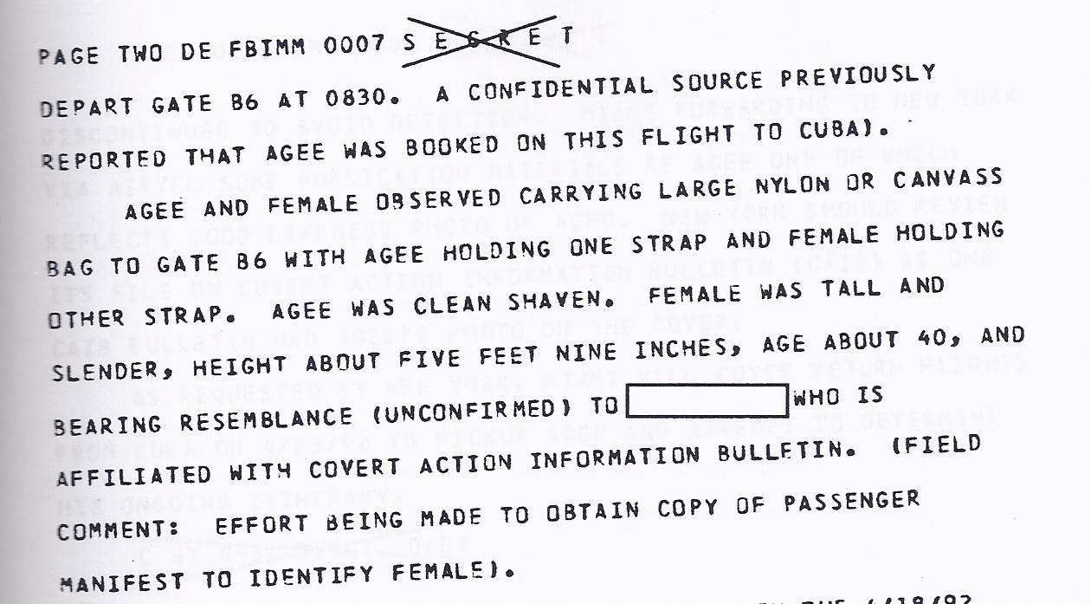
Affiliation with Covert Action Information Bulletin.
August 1991 FBI document

Slide 20
New York office of the FBI interested in Agee’s cooperation with Cuban Mission to the U.N.
April 1,1992 document

Slide 21
Agee had used a Nicaraguan passport

Slide 22
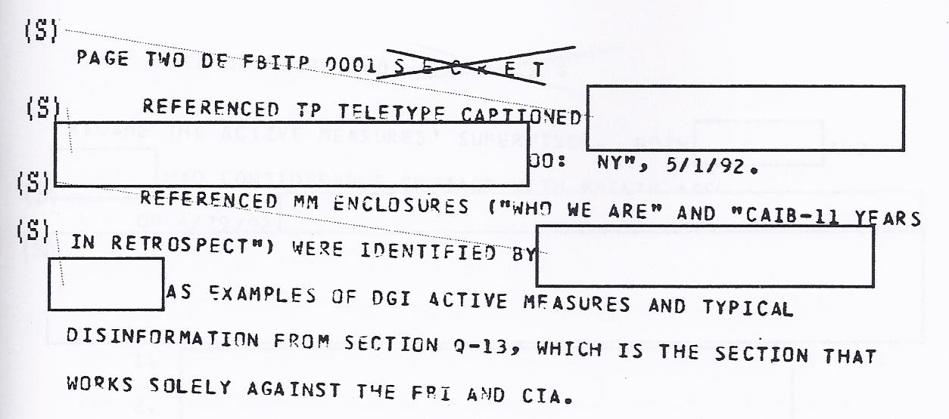
Agee said to be part of Communist “active measures” and “disinformation” operations through the Cuban DGI.
May 1992 FBI document

Slide 23
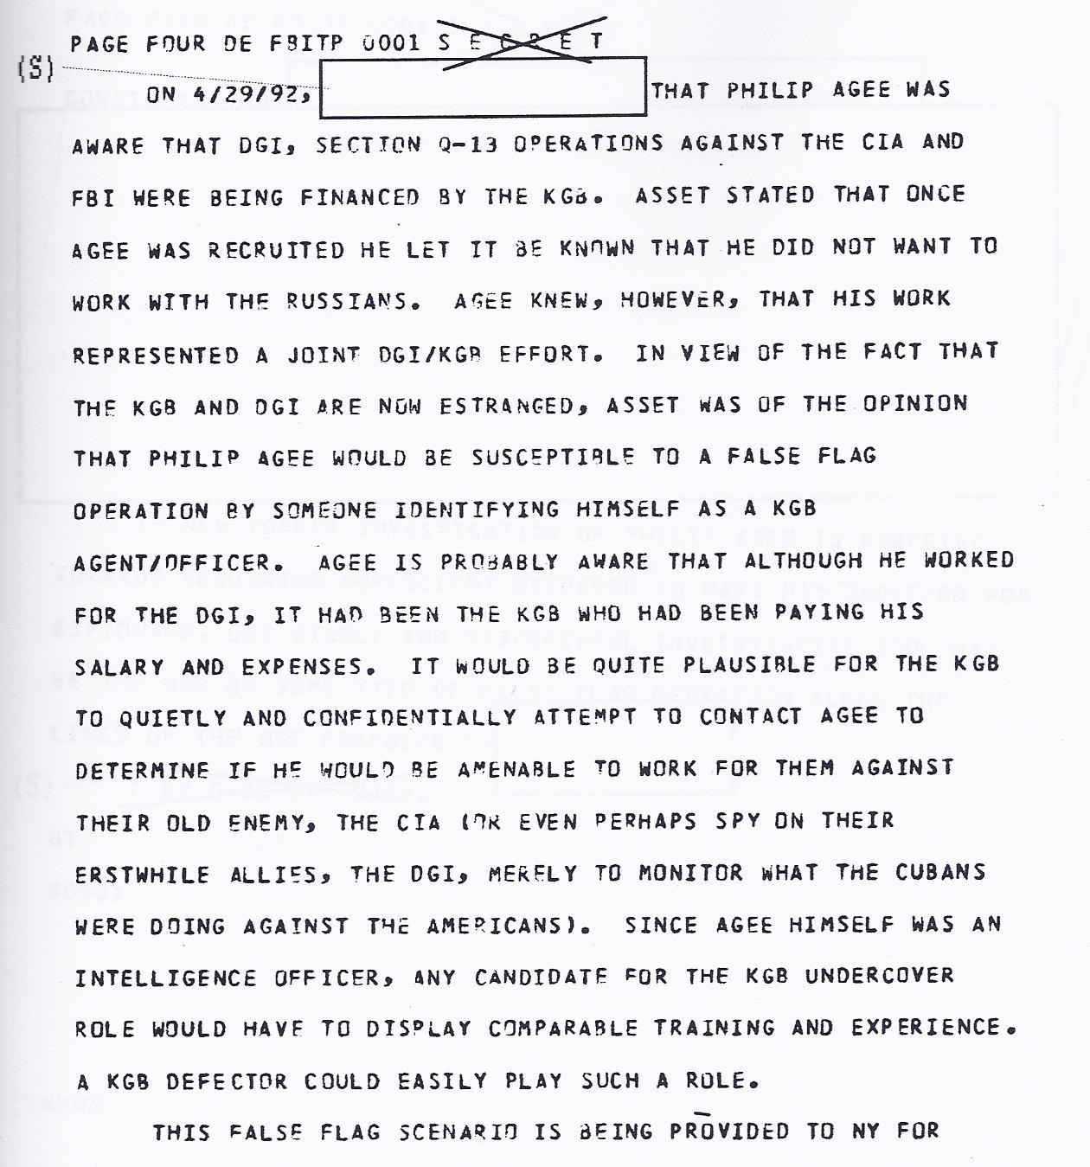
Agee understands he is a player in DGI/KGB operations.
May 1992 FBI document.

Slide 24
FBI wants to prosecute Agee for espionage
May 1992 FBI document

Slide 25
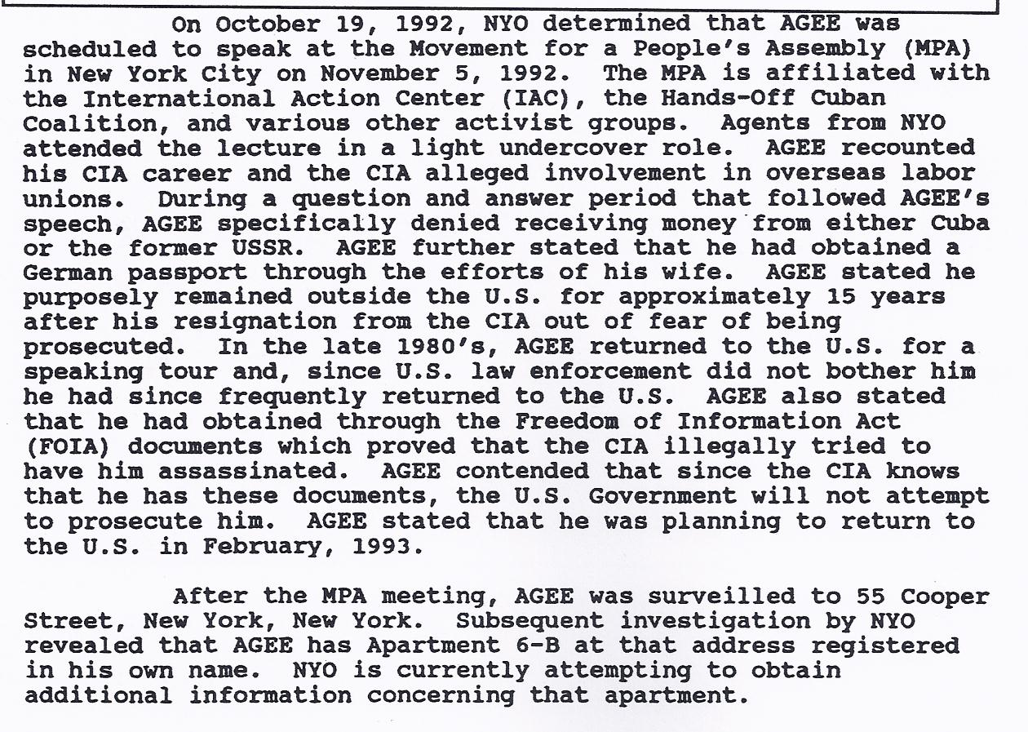
Agee is working with U.S. “activist groups.” In 1980s, U.S. law enforcement “did not bother him.” The International Action Center is a Workers World Party front.
December 16, 1992 FBI document

Slide 26
New York FBI office interested in Agee’s cooperation with Cubans.
December 16, 1992 FBI document

Slide 27
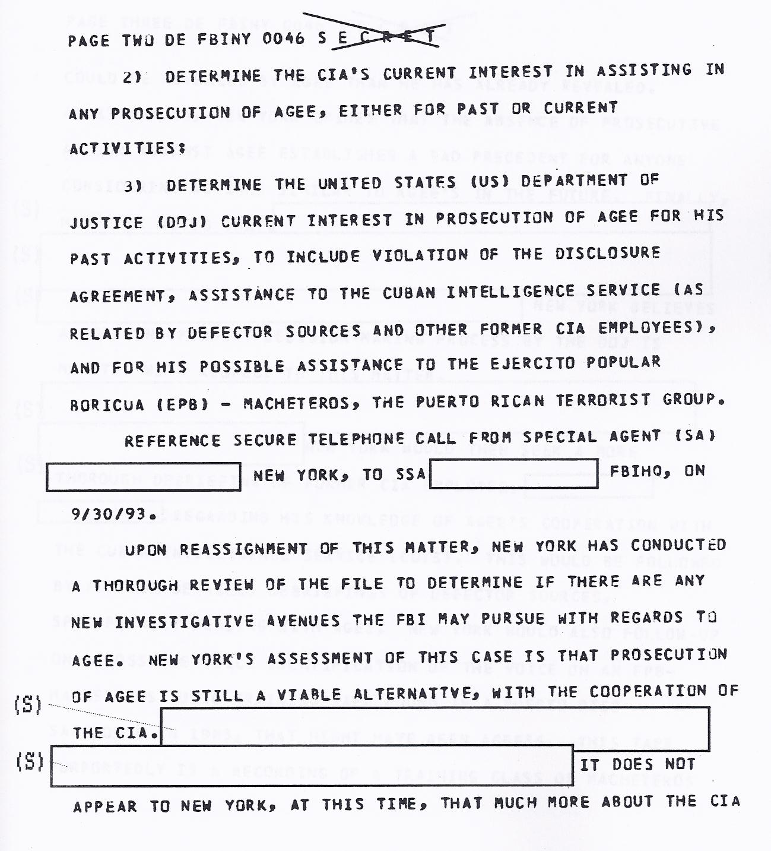
FBI wants to know if DOJ will prosecute Agee and investigate his possible assistance to Puerto Rican Macheteros.
September 1993 FBI document.

Slide 28
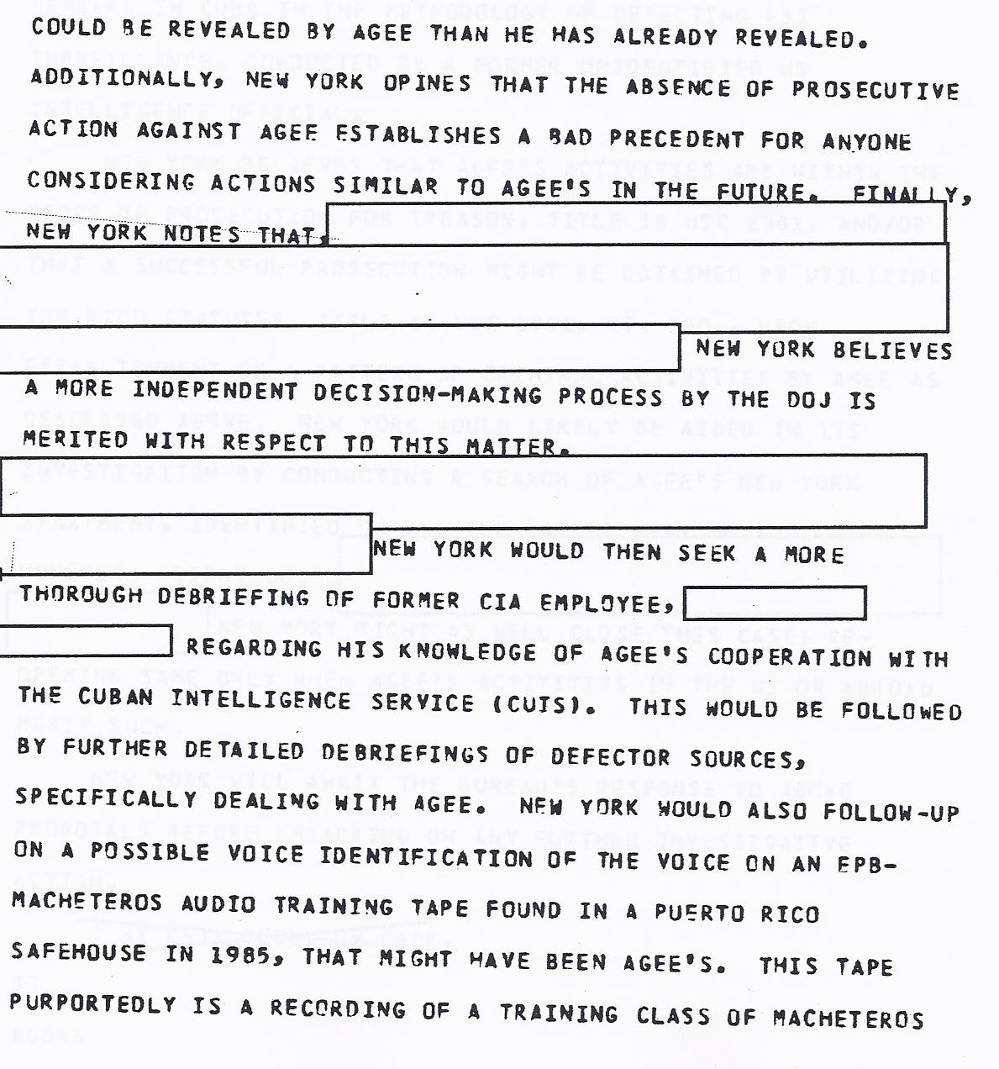
More interest in prosecuting Agee.

Slide 29
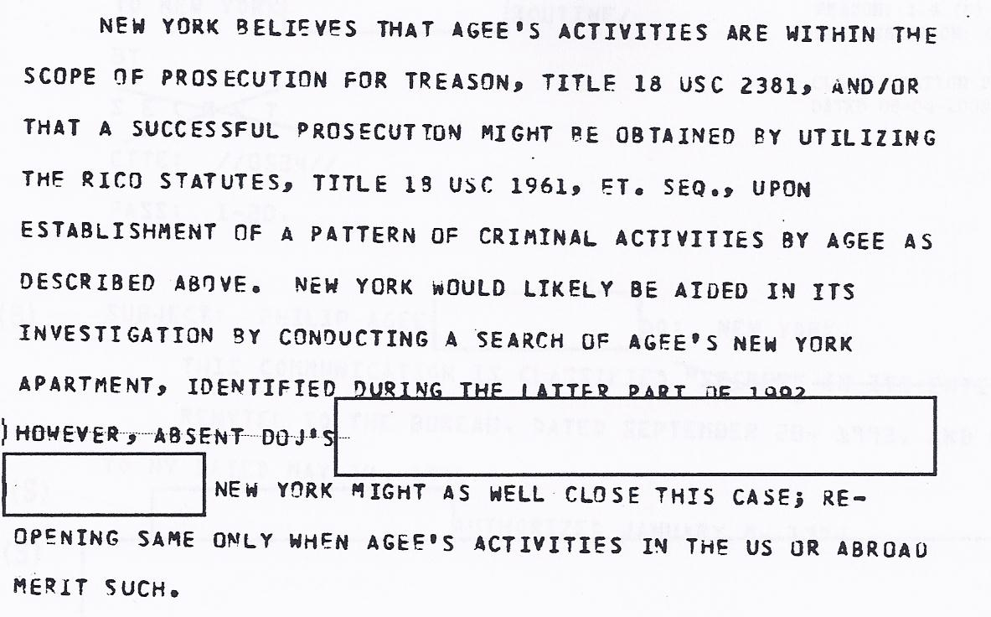
Interest in prosecuting Agee for treason.

Slide 30
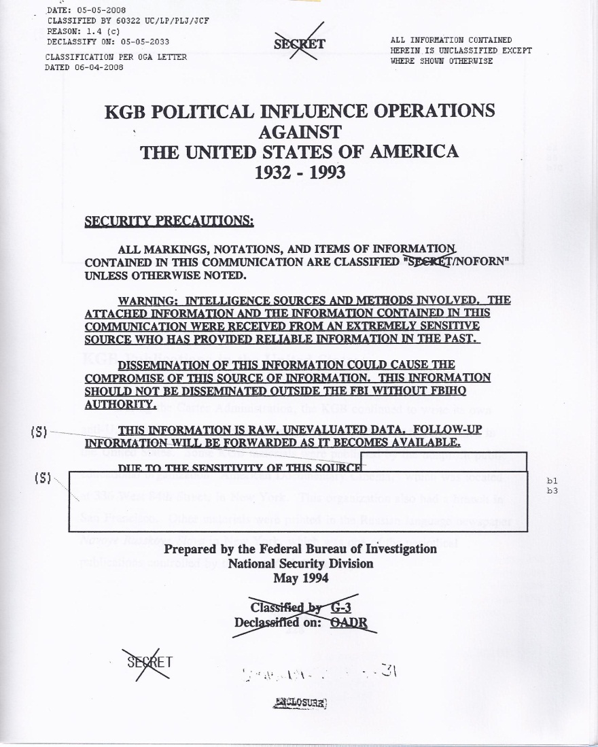
2008 FBI document suggests Agee involved in KGB political influence operations.

Slide 31
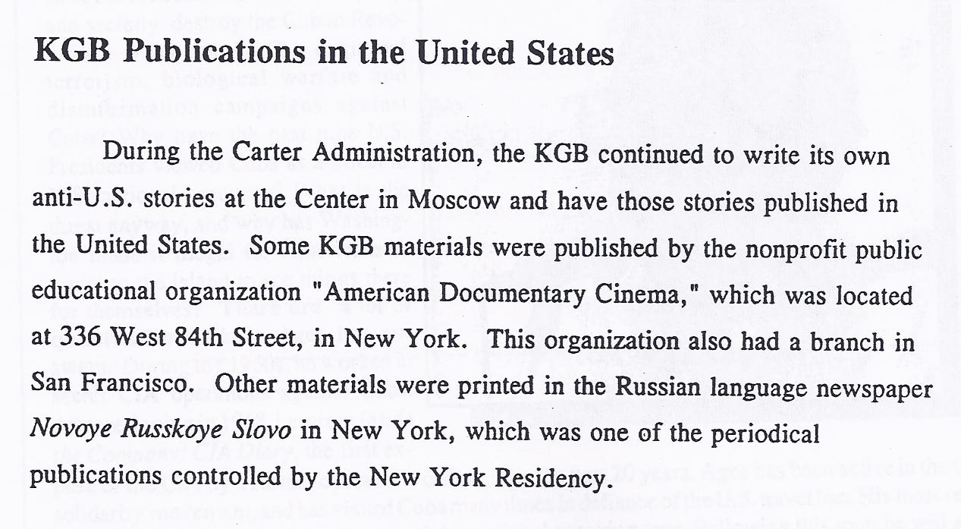
FBI comments on KGB activities in U.S.

Slide 32
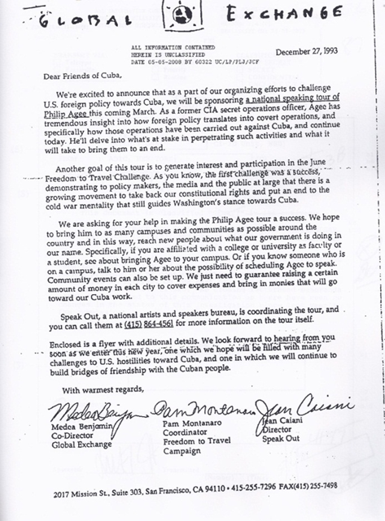
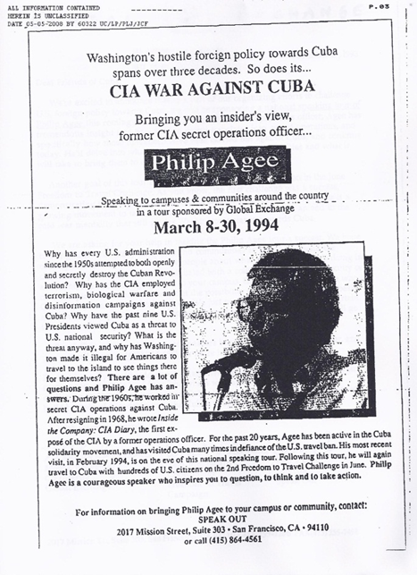
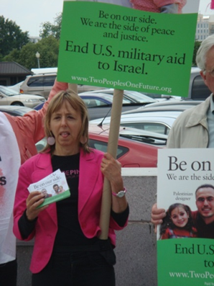
FBI monitors Agee working with “Global Exchange” – founded by Medea Benjamin of Code Pink (right), an associate of Bernardine Dohrn. The FBI file includes a flyer of Medea Benjamin’s Global Exchange promoting Agee speaking tour

Slide 33
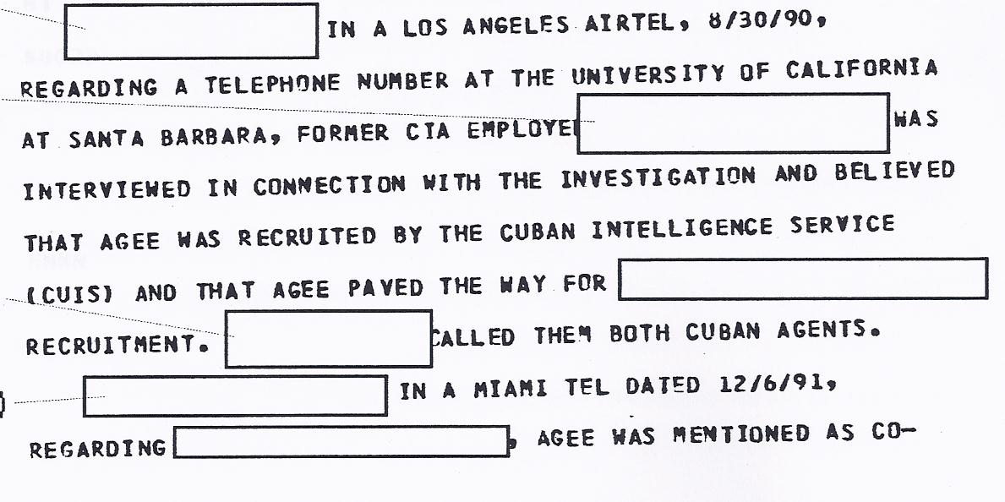
October 1994 document again refers to Agee being recruited by Cuban intelligence.

Slide 34
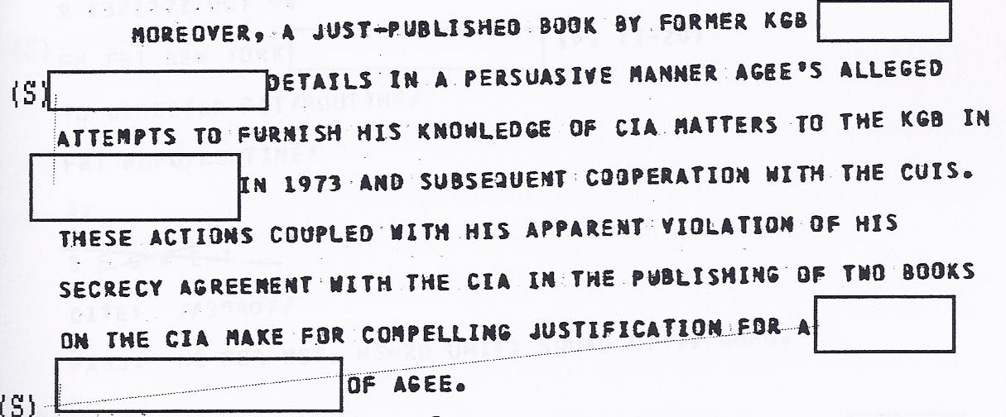
November 1994 FBI document refers to Agee’s contacts with the KGB in just-published book – the Kalugin book. Calls book “persuasive.”

Slide 35
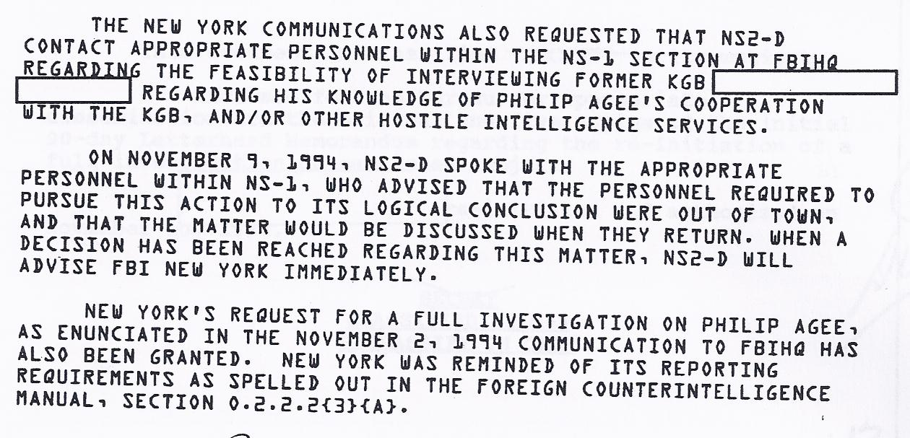
11/10/94 FBI documents suggests interviewing Kalugin about Agee. New York FBI wants a “full investigation” of Agee.

Slide 36
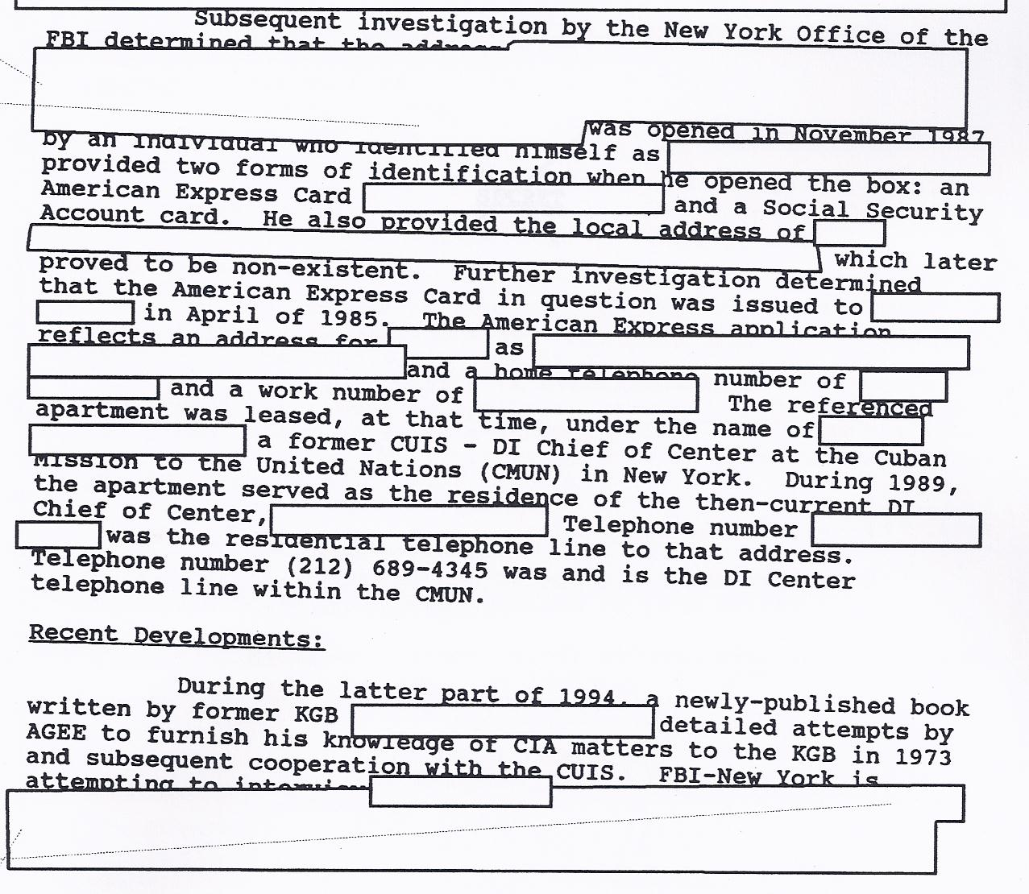
FBI wants new probe of Agee.

Slide 37
FBI wants to review CIA files on Agee for evidence of espionage. Date 5/22/08.

Slide 38
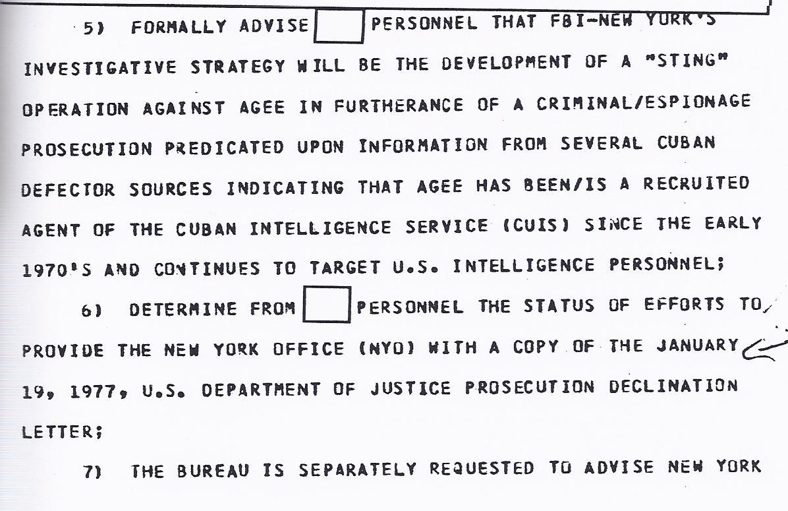
FBI document alludes to DOJ refusing to prosecute Agee in 1977.

Slide 39
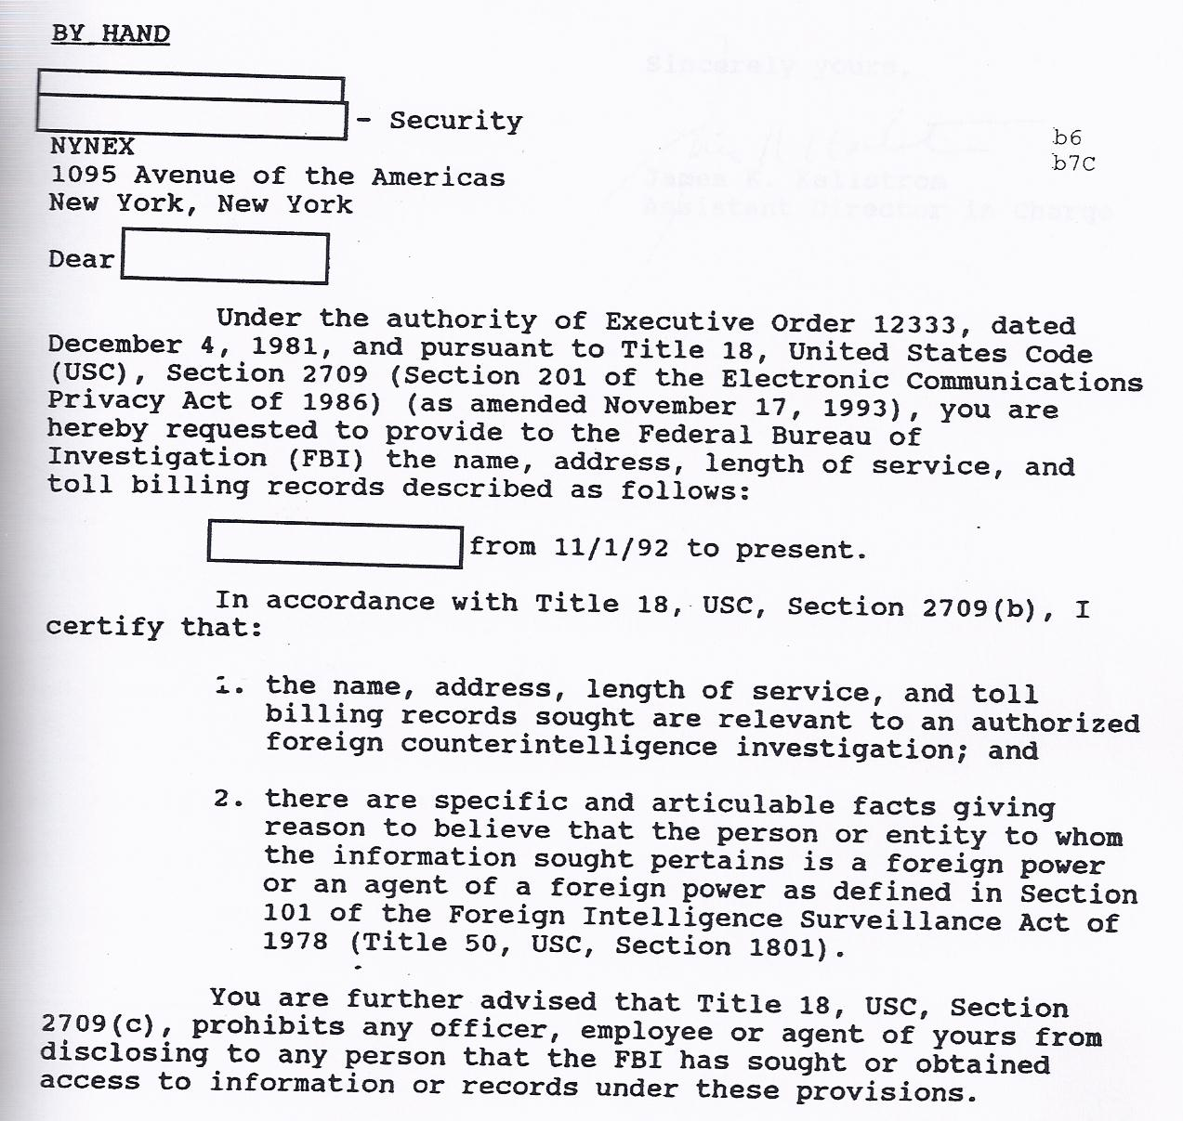
November 12, 1996 FBI document refers to investigation of Agee as an agent of a foreign power.

Slide 40
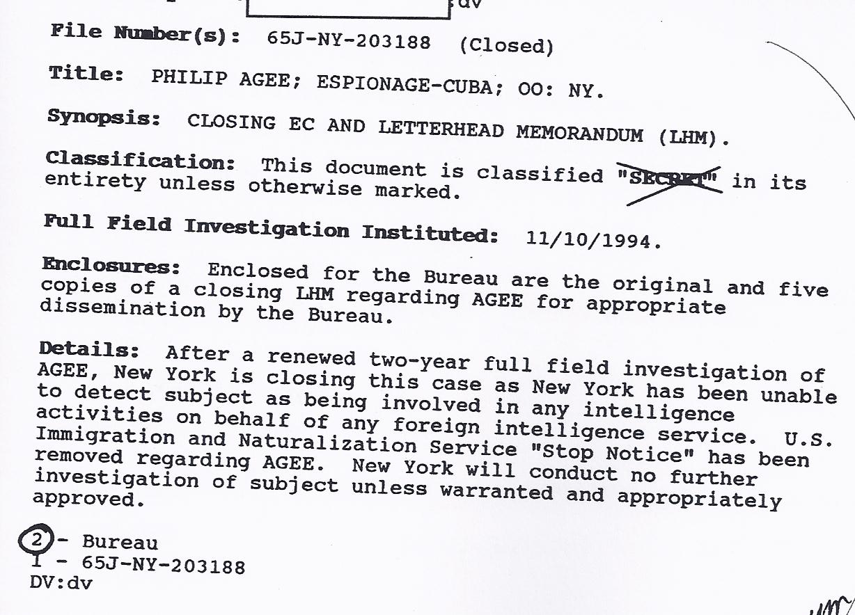
11/12/96 FBI document announces closing of investigation because he is no longer involved with foreign intelligence service.

